Slide 1
Lean design game
Erasmus+
Project LEAN 2015-2017
Lean Design Game
developed by
Ignace Martens
KU Leuven
Introduction

Slide 2
Content
A serious game
Aims of the game
Product
Game
Literature
Orders
Start layout
Team board
Dashboard

Slide 3
1. A serious game
Source: www.futurelab.org.uk

Slide 4
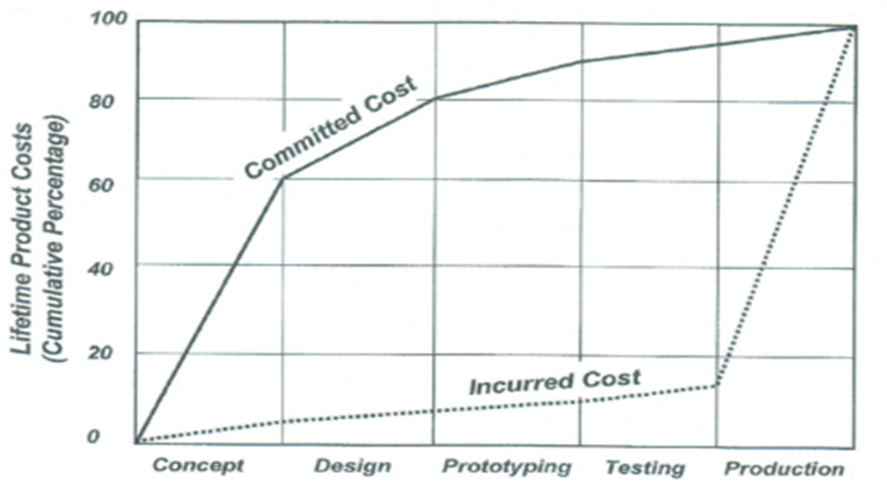
2. Aims of the game
The aim of this game is to learn how to improve
a design process
to solve communication problems
to optimise product design
to speed up design lead time
to avoid redesign work
to cut design costs
Incurred costs
Committed costs

Slide 5
3. Product
Customer specific
Dimensions
Container volume
Spoiler
Maximum load
Cabin shape
Container temperature range
Optional add-ons
Tailboard
Flashing lights
Front and rear fog lights

Slide 6
4. Game
LDG introduction-v<i>.pptx
LDG support-v<i>.pptx
Introduction
(trainer)
Improvement
actions
(participants)
Improvement
actions
(participants)
Conclusions
(trainer +
participants)
Round
1
Round
2
Round
3

Slide 7
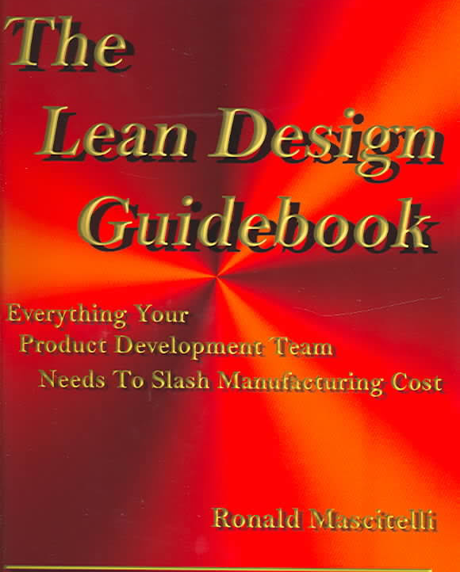
5. Literature
‘The Lean Design Guidebook’
-Ronald Mascitelli
18 lean design tools:
Quality Function Deployment
Standard components
Platforms
Toyota’s principles of Set-Based Concurrent Engineering
Set-Based Concurrent Engineering

Slide 8
6. Orders
Container volume
# wheels
Refrigerator
Dimensions
Add-ons

Slide 9
7. Start layout

Slide 10
8. Team board
TEAM BOARD | Round 1 | Round 2 | Round 3
KPI’s
Committed cost
Design throughput time
# designs too late
# sent e-mails
# redesign steps
# designs-in-progress
# design errors
Problems
Improvement actions

Slide 11
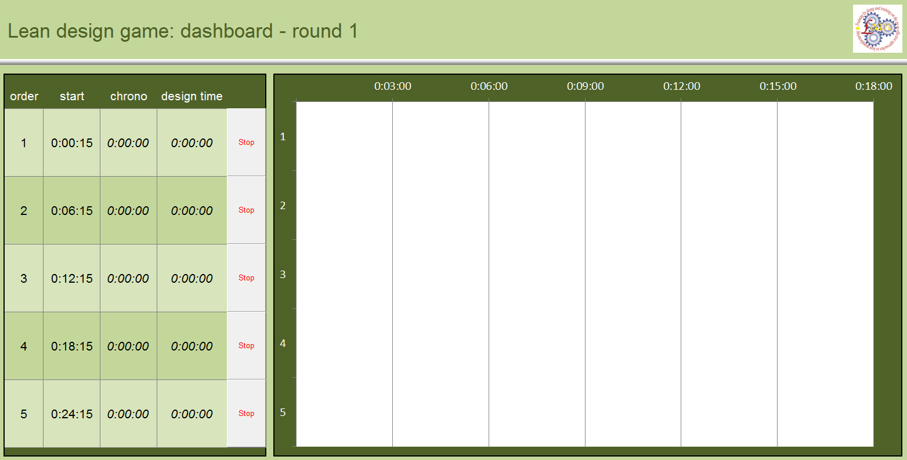
9. Dashboard

Slide 12
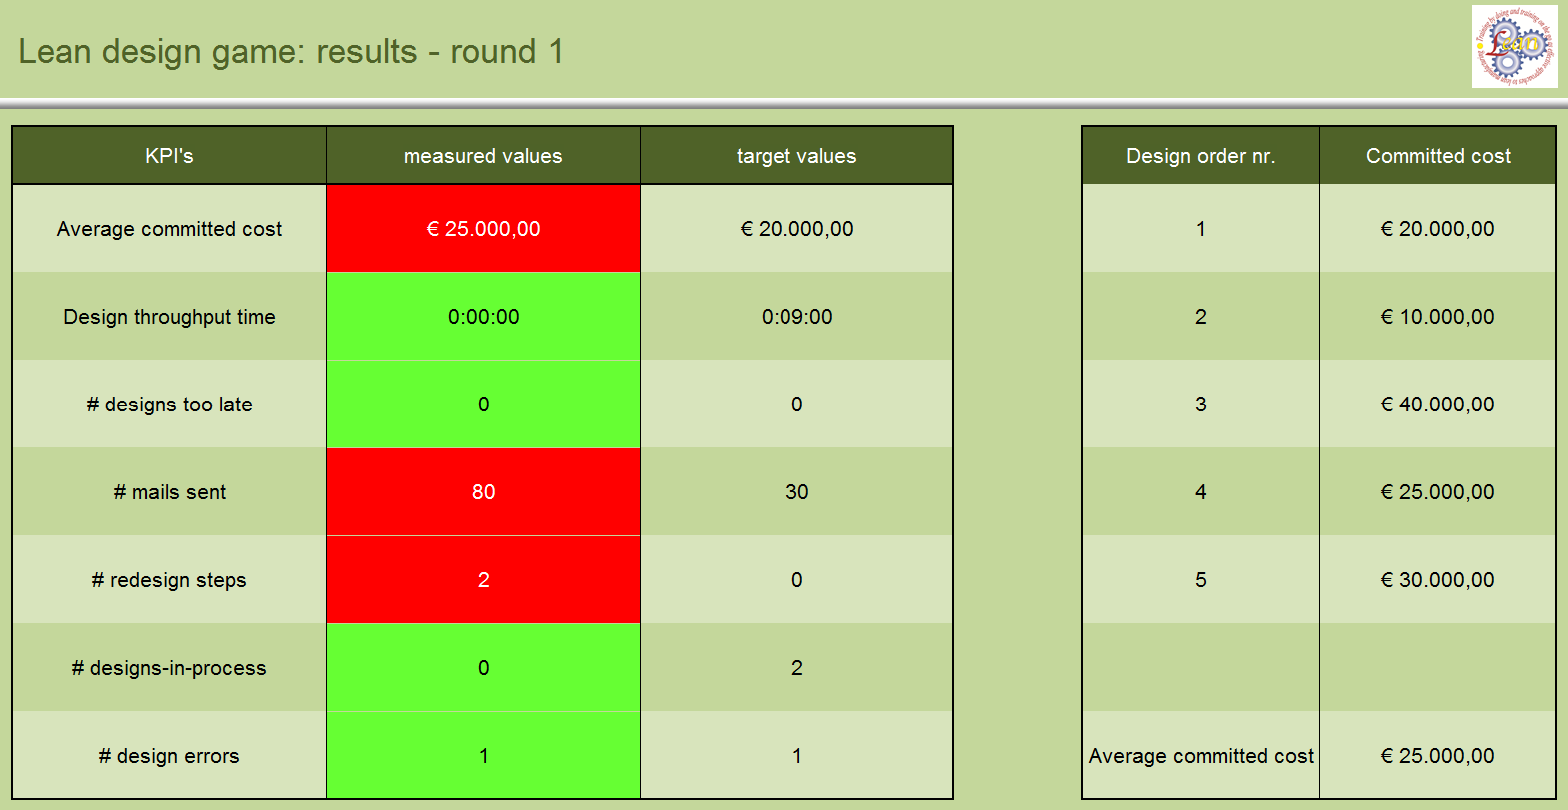
9. Dashboard

Slide 13
Start!
Erasmus+
Project LEAN 2015-2017
Lean Design Game
developed by
Ignace Martens
KU Leuven

