Slide 1
Lean design game
Erasmus+
Project LEAN 2015-2017
Lean Design Game
developed by
Ignace Martens
KU Leuven
Support

Slide 2
Content
Improvement actions
Are you satisfied with this way of designing a truck?
What kind of problems did you face during this round?
Write down on a PostIt and put it on a board
Group similar/related problems
Do you have an improvement action in mind?

Slide 3
Content
Improvement actions
Platforms
Standardisation of supplies (refrigerators)
Communication
Postponing design decisions
Conclusions

Slide 4
1. Platforms
What can we do to reduce the average design throughput time?
Is it efficient to start each order from scratch? What else can we do?
What do you see when you compare the 9 available orders?
Are some orders similar?

Slide 5
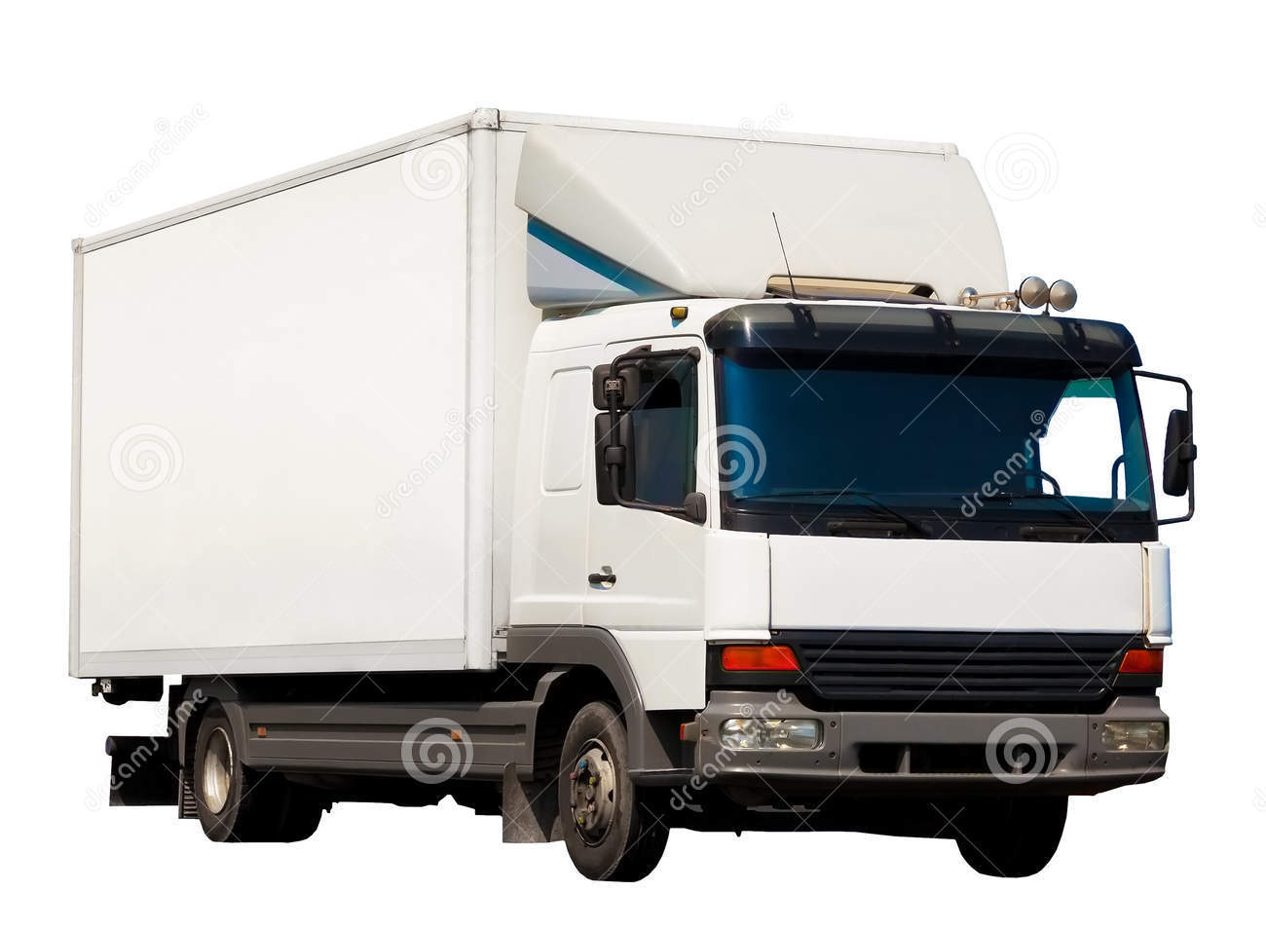
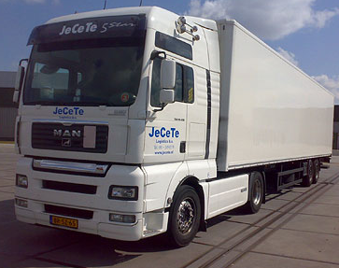
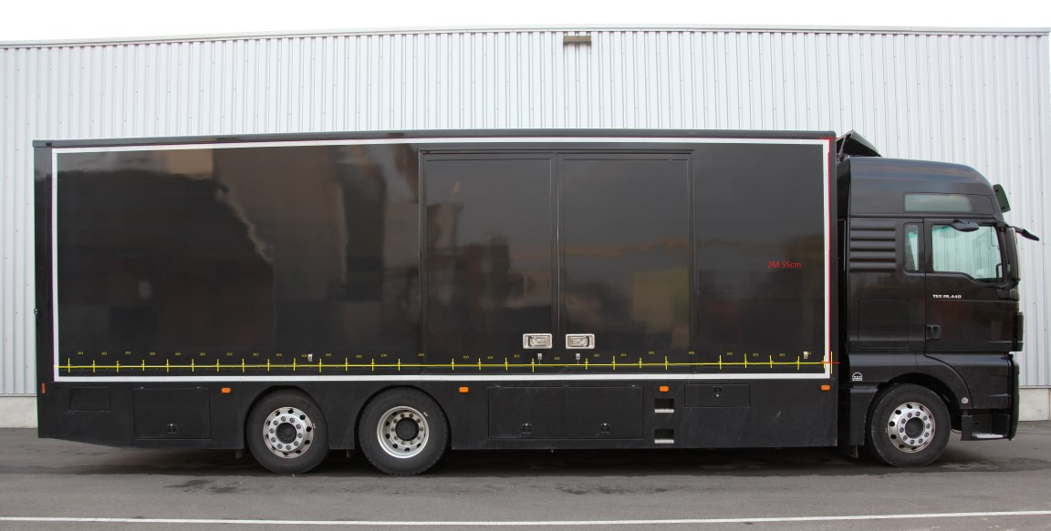
1. Platforms
9 customer specific orders
3 x 3 similar orders (3 market segments)
Segment 1 | Segment 2 | Segment 3
City delivery | B2B delivery | International transport
Small volumes, manoeuvrability | Medium volumes | High volumes, long distances
Order 1, 3, 5 | Order 2, 6, 9 | Order 4, 7, 8

Slide 6
1. Platforms
How many platforms should we create?
How do these platforms look like? What are the parts belonging to a platform?
Has every product feature the same value for the customer?

Slide 7
1. Platforms

Slide 8
1. Platforms

Slide 9
1. Platforms

Slide 10
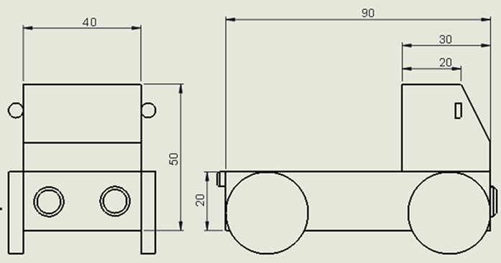
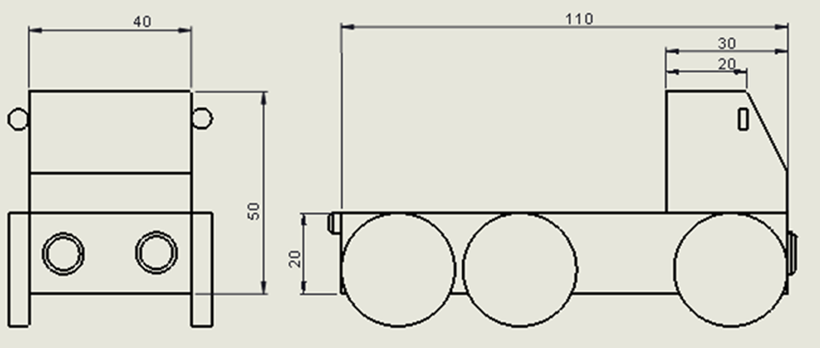
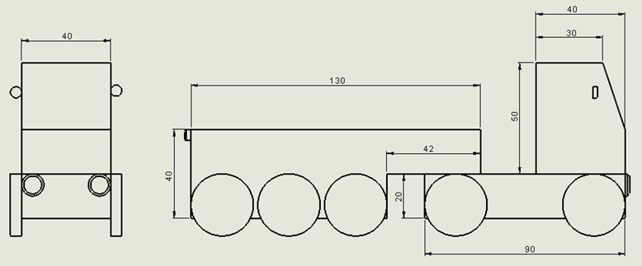
1. Platforms
Segment 1 | Segment 2 | Segment 3
City delivery | B2B delivery | International transport
Small volumes, manoeuvrability | Medium volumes | High volumes, long distances
Order 1, 3, 5 | Order 2, 6, 9 | Order 4, 7, 8

Slide 11
2. Standardisation of refrigerators
Can all refrigerators from those 3 catalogues be used?
What is the advantage of reducing the number of different refrigerators to choose from?
What can we do to reduce the number of different refrigerators to choose from?
Is it necessary for each new order to calculate the required cooling power?

Slide 12
2. Standardisation of refrigerators

Slide 13
2. Standardisation of refrigerators

Slide 14
3. Communication
With which activity do we still lose a lot of time?
Is it possible to know in advance which information is needed by each design department?
Is it possible to deliver these data earlier to those design departments?

Slide 15
3. Communication

Slide 16
3. Communication

Slide 17
3. Communication

Slide 18
3. Communication

Slide 19
4. Postponing design decisions
= aspect of Set-Based Concurrent Engineering
Are our final designs optimal?
Are you sure no better designs are possible?
Did we try and evaluate alternative designs until now?
Can we decide on the best possible design in advance and without making calculations?

Slide 20
4. Postponing design decisions
e.g. platform 2 truck with 120cm³ container at 2°C
Refrigerator
in front of
container

Slide 21
4. Postponing design decisions
e.g. platform 2 truck with 120cm³ container at 2°C
Refrigerator
on top of
container

Slide 22
Conclusions
What’s the impact of the improvement actions on our KPI’s?
KPI’s | 1. Platforms | 2. Standardisation of supplies | 3. Communication | 4. Postponing design decisions
Average design time
Average committed cost
# designs too late
# wrong designs
# redesigns
# sent mails
Designs-In-Progress

Slide 23
Conclusions
What’s the impact of the improvement actions on our KPI’s?
KPI’s | 1. Platforms | 2. Standardisation of supplies | 3. Communication | 4. Postponing design decisions
Average design time | + | + | + | -
Average committed cost | + | + |  | +
# designs too late | + | + | + | -
# wrong designs | + | + |  | +
# redesigns | + | +
# sent mails | + |  | +
Designs-In-Progress | + | + | + | -

Slide 24
Thank you! for your participation and collaboration during this game
Erasmus+
Project LEAN 2015-2017
Lean Design Game
developed by
Ignace Martens
KU Leuven

